Slide 1

Malware Data Analysis
By Stalin Chetty
Guide: Sir.Vishal Badgujar

Slide 2

What Is Elasticsearch?
Elasticsearch is a distributed document-oriented search engine, designed to store, retrieve, and manage structured, semi-structured, unstructured, textual, numerical, and geospatial data
It was built by Apache Lucene. Since its release in 2010, Elasticsearch has quickly become the most popular search engine and is commonly used for log analytics, full-text search, security intelligence, business analytics, and operational intelligence use cases.

Slide 3

What is Kibana ?
Kibana is a data visualization and exploration tool used for log and time-series analytics, application monitoring, and operational intelligence use cases. It offers powerful and easy-to-use features such as histograms, line graphs, pie charts, heat maps, and built-in geospatial support

Slide 4
How it works ?
There are different platforms that elasticsearch can be used such as Kali Linux, Ubuntu and Windows .
Firstly I have downloaded the Elasticsearch and Kibana from the website and extracted the file and start running the sources.
For Elastiscsearch: Go to the bin folder of elasticsearch , enter cmd in the cmd we have to write the command “elastiscsearch.bat” it starts performing the tasks that are placed in the bat file . It provides us with the Password ,the user name and the token to enter into the kibana .
For Kibana : Go to the bin folder of Kibana , enter cmd in the cmd place the command “kibana.bat” its starts performing the tasks and provides us the localhost platform.

Slide 5
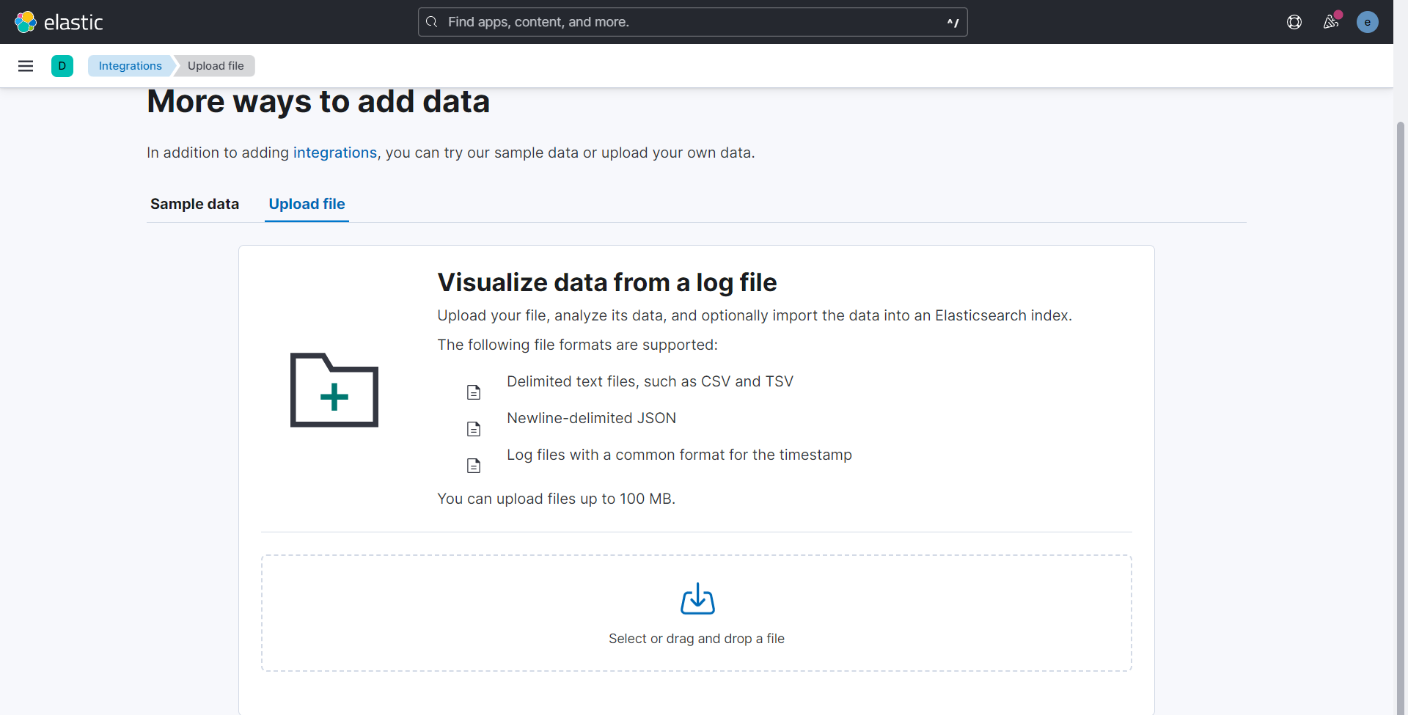
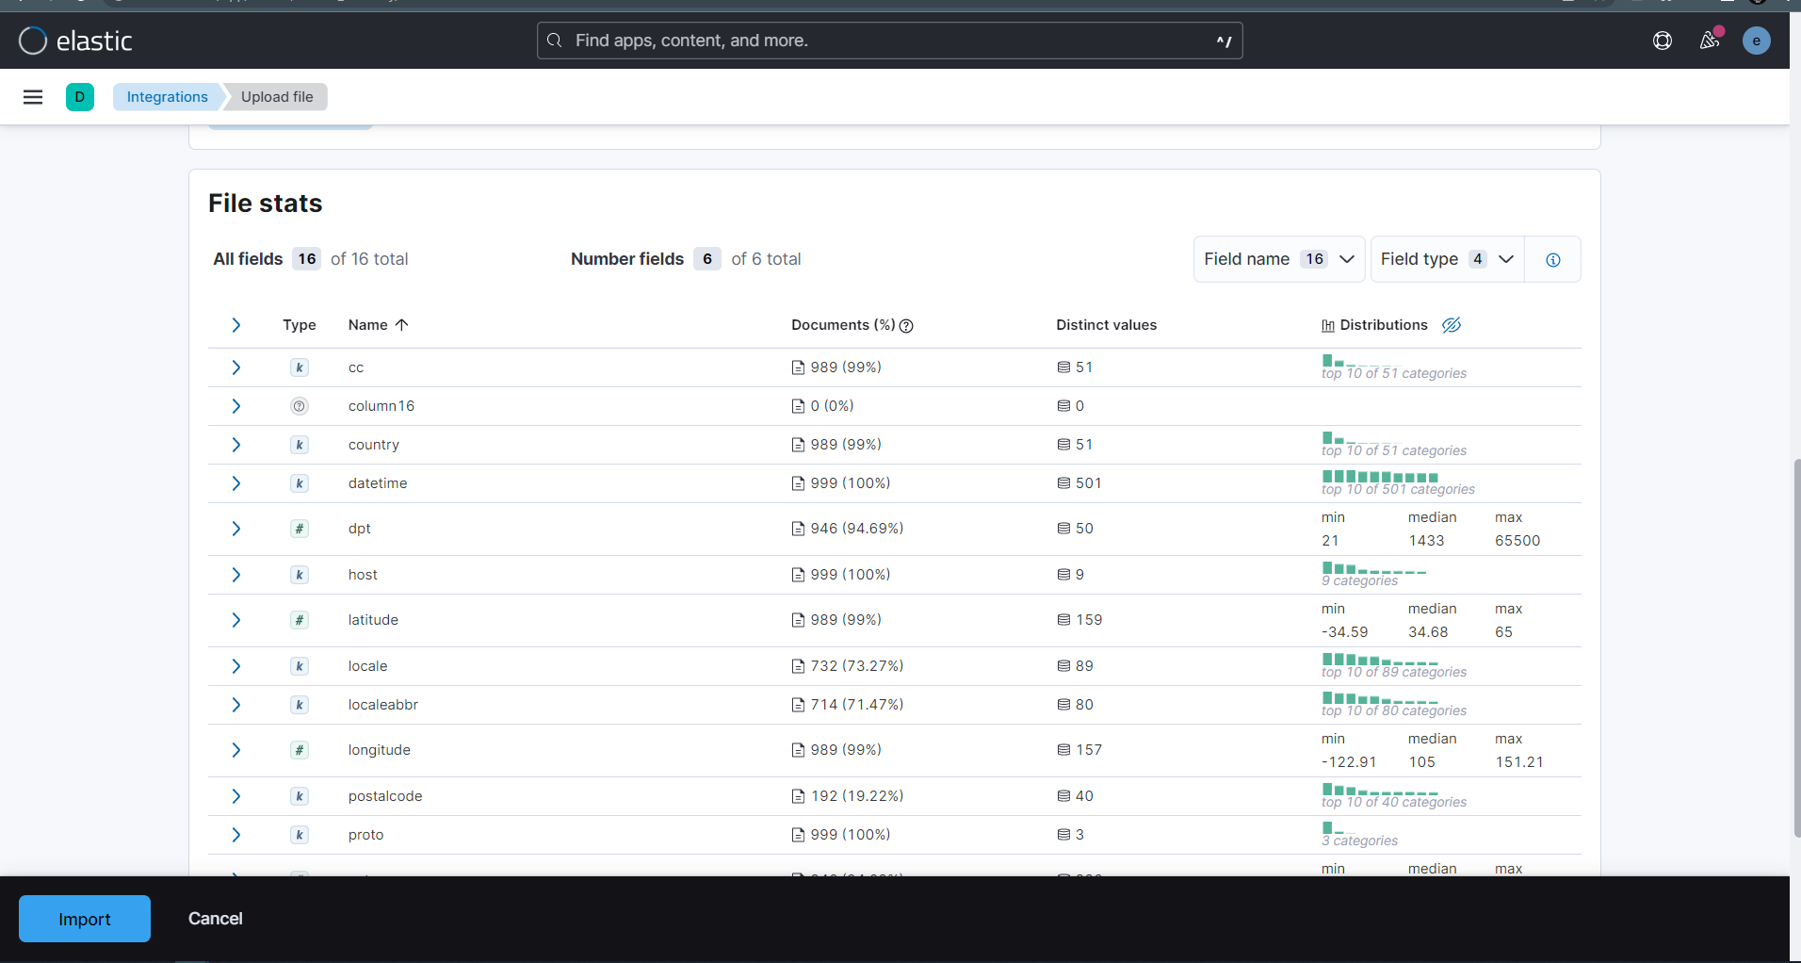
After entering Kibana localhost we must upload the Datasets file and it visualizes the data.
The Dataset file that we have used is about phishing attack that took place on the internet.
The file size of the dataset is 44,595KB. It provides the details of the url’s of the attacked website and the type of attack that took place such as phishing ,defacement, malware and bengin.
The next step is to upload the dataset into the kibana and import it to data visualization mode, and then we can view it in graphical mode.

Slide 6
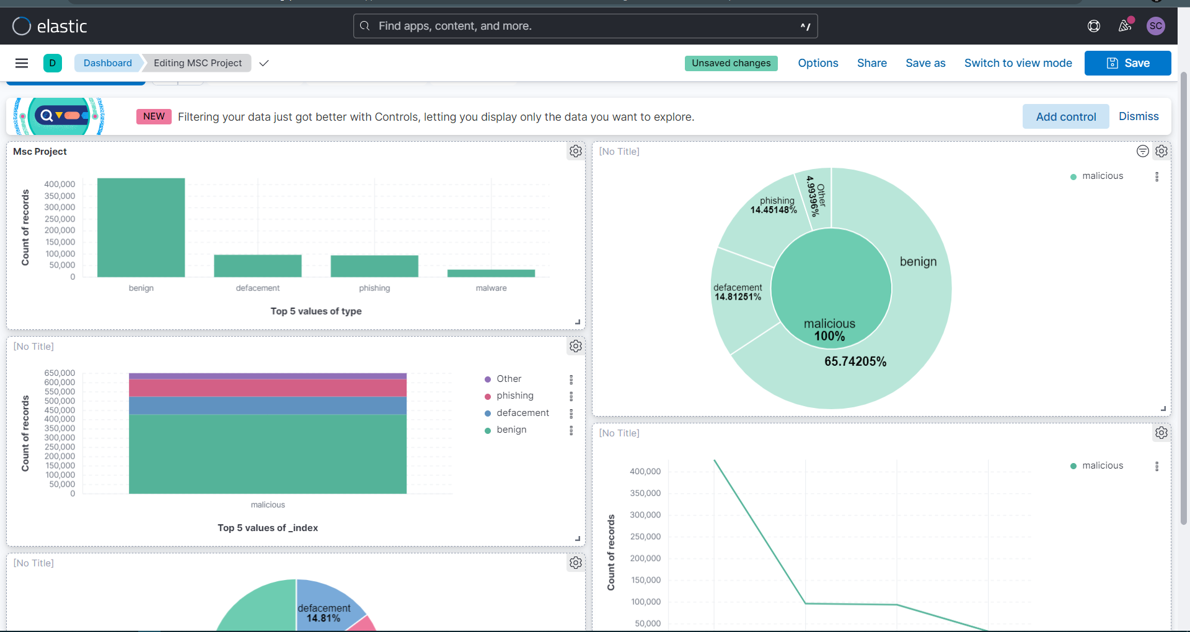
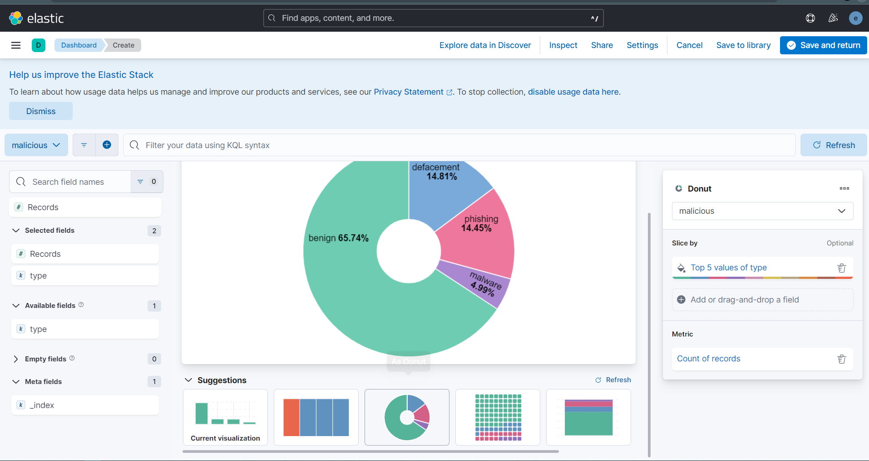
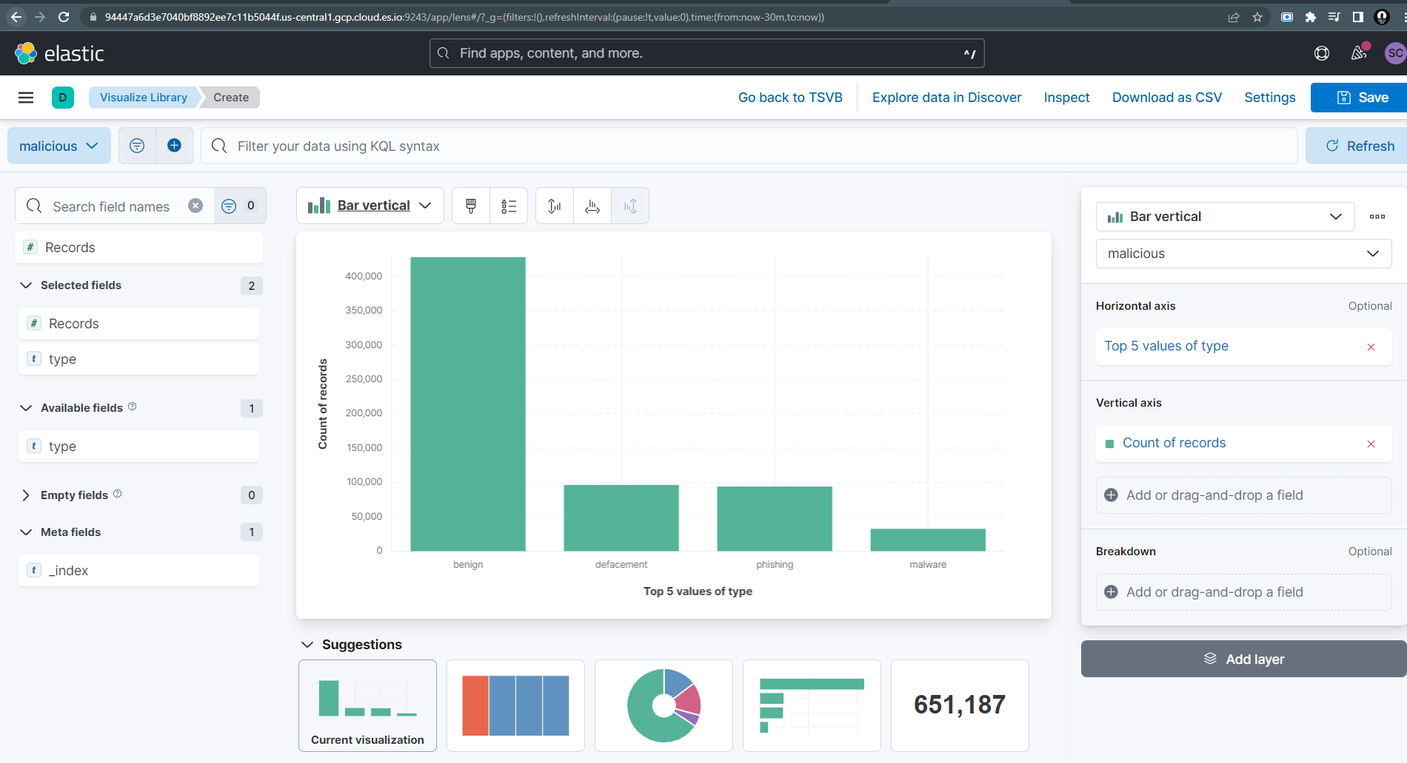
After adding the dataset in the kibana to analysis, next we have to create a dashboard to visualization the dataset in the graphical format such as the histogram , percentage, pie and etc.
And we can add each graphical format into one dashboard and view it. If necessary we can save and download the data.

Slide 7
Thank you

